Slide 1
UV LIGHT TREATMENT FOR PATHOGEN REDUCTION IN FOOD PRODUCTS
GROUP MEMBERS:
1. VEDANT ATHAVALE (181090071)
2. ADITI PATIL (181091003) 3. DHRUV SINGH (181090064)
4. TEJAS ADHIKARI (181090068)

Slide 2
About our Project
Status and scope of ultraviolet (UV) light technology in food processing industry
Increasing use in recent years
Competitive procedure
Useful tool for food safety
Future of UV technology in food processing industry.

Slide 3
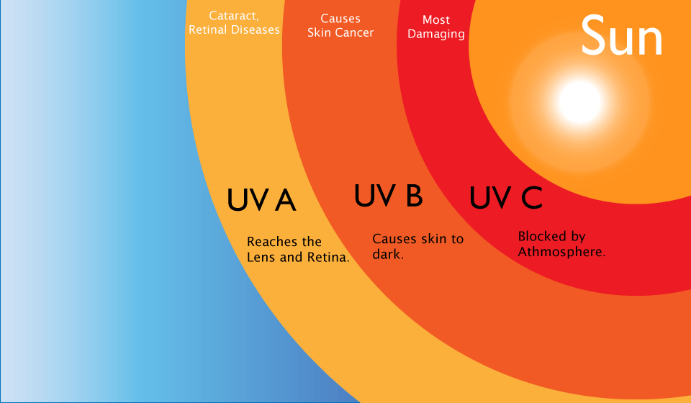
How is UV Light related to EMW?
Ultraviolet (UV) is a form of electromagnetic radiation with wavelength from 100 (with a corresponding frequency around 30 PHz) to 400 nm (750 THz), shorter than that of visible light, but longer than X-rays.

Slide 4
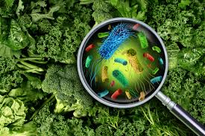
Introduction
Pathogenic microorganisms
Disease outbreaks
Demand for methods to reduce the risks associated
UV Treatment - increases the shelf life of food
Eliminates the use of chemicals for disinfection.

Slide 5
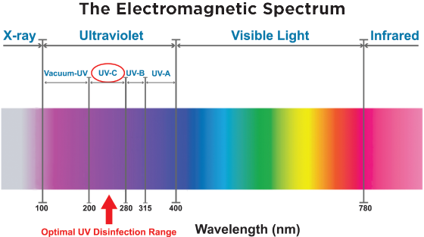
UVC Region
UVC light is part of the ultraviolet light spectrum and emits a high frequency of UV light that makes it extremely effective at killing pathogenic microorganisms.

Slide 6
How is UV Light beneficial?
Absorption of UV Light by proteins can lead to rupture of cell walls and death of the organism.
Absorption of UV Light by DNA or RNA is known to cause inactivation of the DNA or RNA
The Bacteria Cannot Replicate.
CELLS THAT CANNOT REPLICATE, CANNOT INFECT
It is widely accepted that it is not necessary to kill pathogens with UV light, but rather apply enough UV light to prevent the organism from replicating.

Slide 7
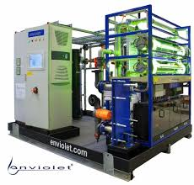
UV Treatment of Fresh Produce:
Often a low level of UV radiation (as low as 130- 4000 mJ/cm2) is used on the fresh produce so as to increase the shelf life of peaches and tomatoes.
The low initial cost of continuous-wave UV as well as the lack of extensive safety equipment may benefit those with little capital to invest

Slide 8
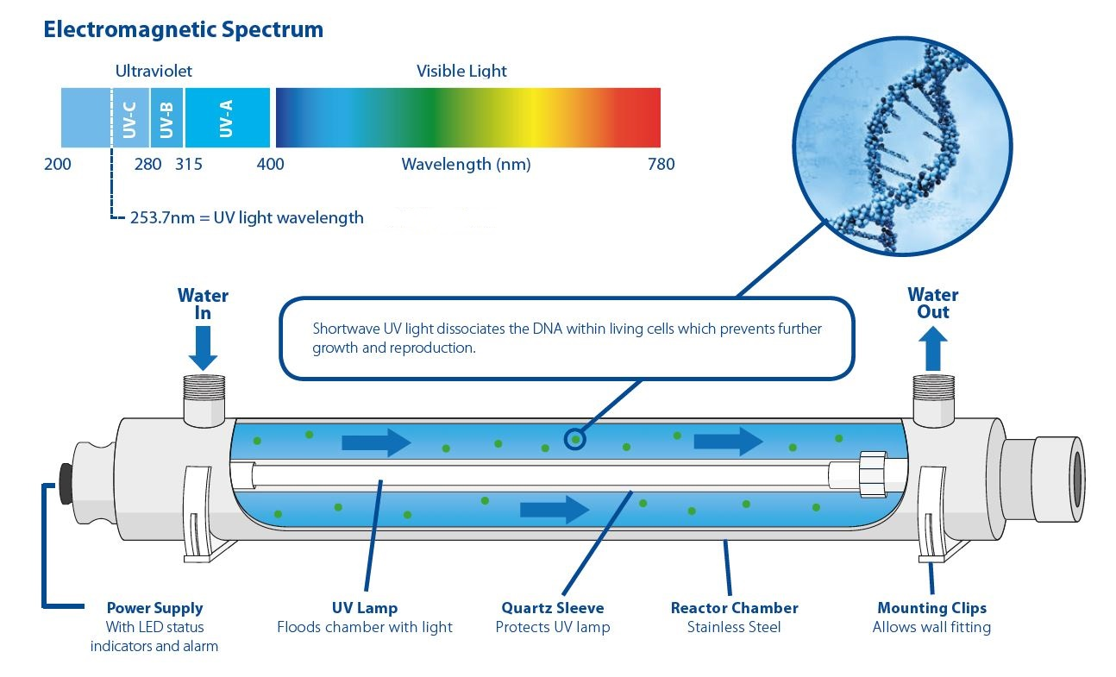
UV Disinfection of Water

Slide 9
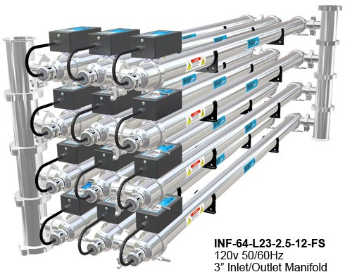
UV Disinfection of Liquid Foods:
Reduction of natural flora in raw cow milk and apple cider vinegar.

Slide 10
What did we learn?
Opportunity in small or large scale food and dairy processing industry.
Superior organoleptic qualities of food products.
Lower initial investment and operating costs.
Great success in sight.

Slide 11
Inference
UV Light:
No significant changes in the organoleptic properties.
Not sufficient to destroy the microorganisms.
No adverse effects.
Safe and no residual effect.
Induces desirable changes in health constituents.
Low initial investment and a lower operating cost of treatment .

Slide 12
References
[1] Choudhary Ruplal & Bandla Srinivasarao. (2012). Ultraviolet Pasteurization for Food Industry. International Journal of Food Science and Nutrition Engineering. 2. 12-15. 10.5923/j.food.20120201.03.
[2] J. Csapo, J. Prokisch, Cs. Albert & P. Sipos.(2019).Effect of UV light on food quality and safety. Acta Universitatis Sapientiae Alimentaria 12(1):21-41.10.2478/ausal-2019-0002.

Slide 13
Thank You!

